Slide 1

2016, 28-30 June – Brescia (I)
(E)merging directions on air pollution and climate change research in Mediterranean ecosystem
Giacomo Gerosa¹, Riccardo Marzuoli¹, Raùl Ochoa Hueso²,
Silvana Munzi³, María Arróniz-Crespo⁴
¹ Università Cattolica of Brescia, Italy
² University of Western Sydney, Australia
³ Universidade de Lisboa, Portugal
⁴ Universidad Politécnica de Madrid, Spain
Brescia, 28 June 2016

Slide 2
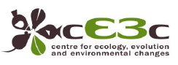
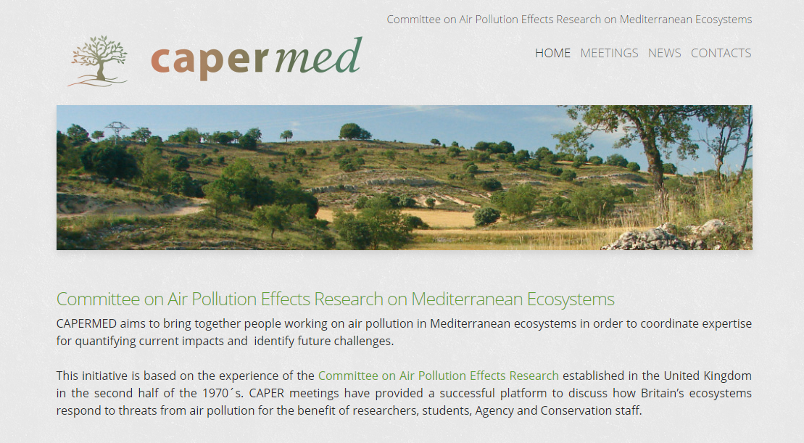
A brief and succesful history
Silvana Munzi

Slide 3

A brief and succesful history
Silvana Munzi
Oh no, another scientific meeting!!!!!!

Slide 4


A brief and succesful history
Silvana Munzi

Slide 5
A brief and succesful history
Silvana Munzi
CAPERmed 2014 - I Meeting Lisbon, Portugal, 3-4 July
38 participants
(but 11 from Lisbon!)
20 institutions
CAPERmed 2016 - II Meeting Brescia, Italy, 28-30 June
30 participants
+ 4 invited speakers
20 institutions
(but some different)
Review paper submitted to Global Change Biology
(encouraging comments)
NitroMed network
Preparation of two proposals:
Networking
Research

Slide 6
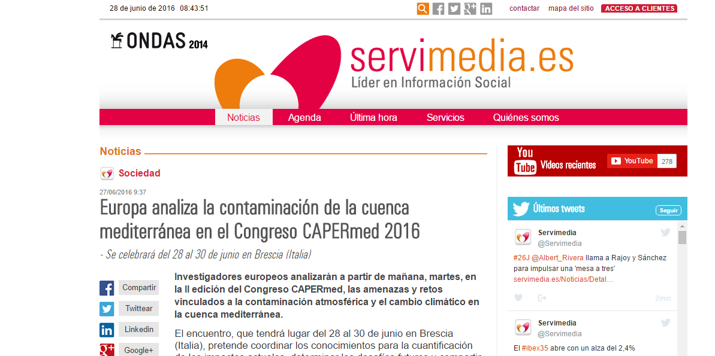
A brief and succesful history
Silvana Munzi

Slide 7


Future challenges
María Arróniz-Crespo
CAPERMED aims to bring together people working on air pollution in Mediterranean ecosystems in order to coordinate expertise for quantifying current impacts and identify future challenges

Slide 8

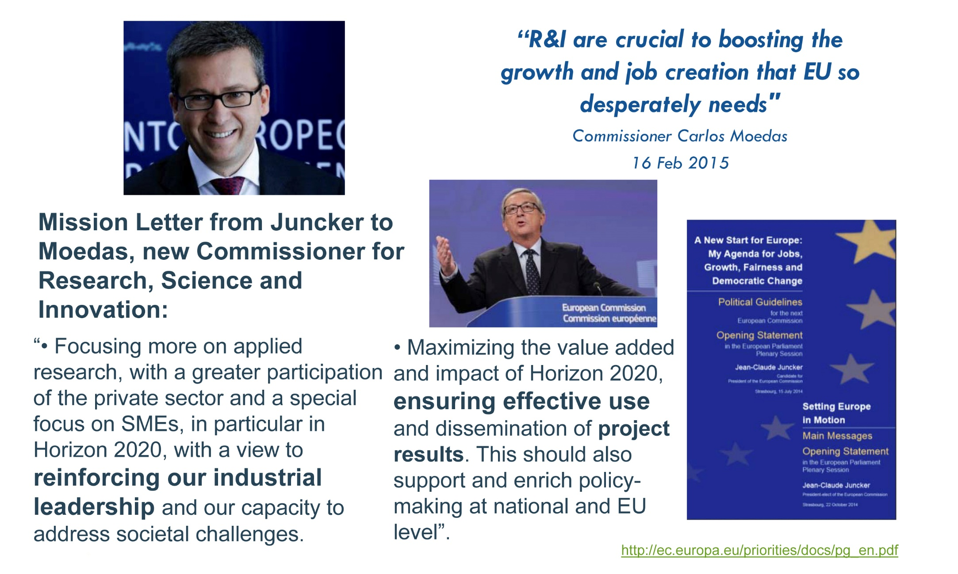
Future challenges
María Arróniz-Crespo

Slide 9
Future challenges
María Arróniz-Crespo
At a time of public budge constraints, major demographic changes and increasing global competition, Europe´s competitiveness, our capacity to create millions of new jobs to replace those lost in the crisis and, overall, our future standard of living depends on our ability to drive innovation in products, services, business and social processes and models. This is why innovation has been placed at the heart of the Europe 2020 strategy. Innovation is also our best means of successfully tackling major societal challenges, such as climate change, energy and resource scarcity, health and ageing…
… the biggest challenge… is to adopt a much more strategic approach to innovation…whereby innovation is the overarching policy objective…where EU and national/regional policies are closely aligned and mutually reinforcing…
COM (2010) 546 6.10.2010

Slide 10
Future challenges
María Arróniz-Crespo
A break with the past
The name of the new program of R & I -Horizonte2020- EU reflects the ambition to create ideas, growth and jobs in the future ... will be a key tool for the Innovation Union
H2020 brings together all sources of funding for R & I of the EU ( FP , CIP, EIT)
KEY NEWS
Inclusive approach open to new participants (non-academic)
Integration of R & I providing continuous and coherent funding from idea to market
More support for activities close to the market
Generate more business opportunities
From laboratory to market through a single , specific, programme

Slide 11
Future challenges
María Arróniz-Crespo
More than 50% of the programme is competitive open call BUT an increasing % is been externalized (initiatives, depend on the topic)

Slide 12
Future challenges
María Arróniz-Crespo
RESEARCH PROFESSIONAL
https://www.researchprofessional.com/0/rr/home
Keywords: Air Pollution + Land Pollution + Agricultural & Natural Resource Economics; Environmental & Ecological Economics + Environmental Economics & Natural Capital + Ecosystem Function
H2020
LIFE+
ERANETs
COST
NIH: National Institute of Health (more than 50% of results)
Europe and global challenges (Volkswagen Foundation, DE and other funders)
Awards

Slide 13
Future challenges
María Arróniz-Crespo
H2020 funding opportunities
WP 16 – 17 (competitive open calls):
RISE, ITN, FETOPEN, SC5, SC2, Cross-cutting activities
Public-public partnership (initiatives):
Art. 185, JPIs, ERA-NETs
(excellent science, still innovation has to be present)

Slide 14

Future challenges
María Arróniz-Crespo
Joint Programming – Art. 185
Article 185 of the TFEU enables the EU to participate in research programmes undertaken jointly by several Member States, including participation in the structures created for the execution of national programmes. The actions supported may cover subjects not directly linked to the themes fo the FP as far as they have a sufficiente EU added value. They will also be used to enhance the complementarity and synergy between the FP and activities carried out under intergovernmental structures such as EUREKA and COST
Partnership for Research and Innovation in the Mediterranean Area (PRIMA). The EU, together with Croatia, Cyprus, Czech Republic, France, Greece, Italy, Luxembourg, Malta, Portugal, Slovenia, Spain and 7 non-EU countries (Algeria, Egypt, Jordan, Lebanon, Morocco, Tunisia and Turkey). The main objective is to reinforce cooperation in research and Innovation in Mediterranean countries in order to contribute to the challenge of sustainable food production and water provision in the Mediterranean region.
https://ec.europa.eu/research/environment/index.cfm?pg=prima

Slide 15



Future challenges
María Arróniz-Crespo
Joint Programming – JPIs
Joint Programming is a new process combining a strategic framework, a bottom-up approach and a high-level commitment from Member States.
Suitable Joint Programming areas have been identified by a High Level Group on Joint Programming (the GPC from the French "Groupe de Programmation Conjointe“. Based on the result of the GPC, the Council, upon a proposal by the Commission, recommended ten areas in which to implement Joint Programming in priority. From there on, participation of Member States in each initiative is "à la carte", based on voluntary commitments leading to partnerships composed of variable groups of countries.

Slide 16



Future challenges
María Arróniz-Crespo
Joint Programming – ERANETs
The ERA-NET under Horizon 2020 merges the former ERA-NET and ERA-NET Plus into a single instrument with the central and compulsory element of implementing one substantial call with top-up funding from the Commission. The focus of ERA-NETs is therefore shifting from the funding of networks to the top-up funding of single joint calls for transnational research and innovation in selected areas with high European added value and relevance for Horizon 2020.
http://ec.europa.eu/research/era/era-net-in-horizon-2020_en.htm
TRANSNATIONAL CALL BUT NATIONAL FUNDING:

Slide 17
2016, 28-30 June – Brescia (I)
Thank you very much and welcome to CAPERmed 2016!

